Slide 1
COMPILER DESIGN
ABHAY AGARWALA
BIKRAM BOOTE
PRIYANK LOHARIWAL
TAMAGHNA SARKAR

Slide 2
QUESTION
A basic syntax and lexical analyzer of C-based programs supporting following features:
Data types - int, char
IO
  get x;(taking x from stdin)
  put x;(printing x at stdout)
Conditional statement syntax: id = expression ? expression: expression;
Relational Operators supported: {>, <, ~}
Arithmetic Operators supported: {+, -, *}
Only main() function is supported. The function may definition may contain arguments and return statement.
White-spaces and new lines within statements are ignored.
Statements end with ;

Slide 3
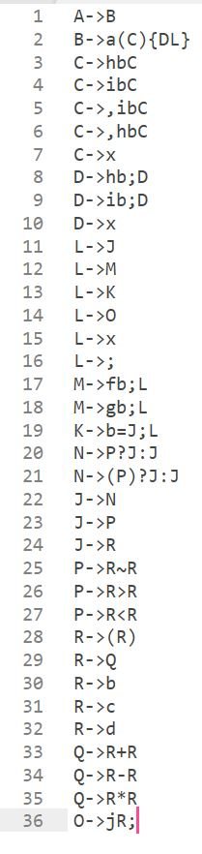
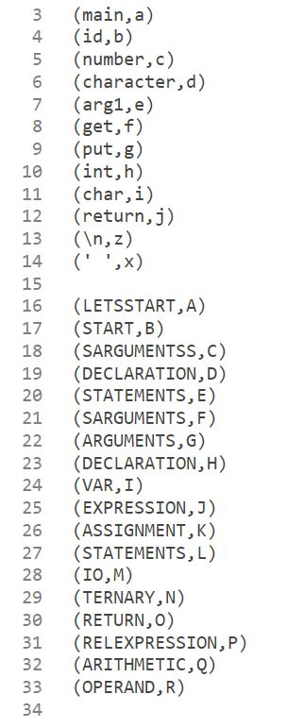
DESIGN
Lexical
Analysis
Construct DFA for tokens of different types.
Check source program for lexical errors.
SLR Parsing
Find FIRST and FOLLOW of non-terminals.
Find closure and GOTO for all item sets.
Add tokens read from source program to SYMTAB until error found.
Construct Context-Free Grammar for the language.
Check validity of the input string by SHIFT or REDUCE or ACCEPT actions from Parsing table based on current stack and input symbol.
Construct Parsing Table.
MAPPING
GRAMMAR

Slide 4
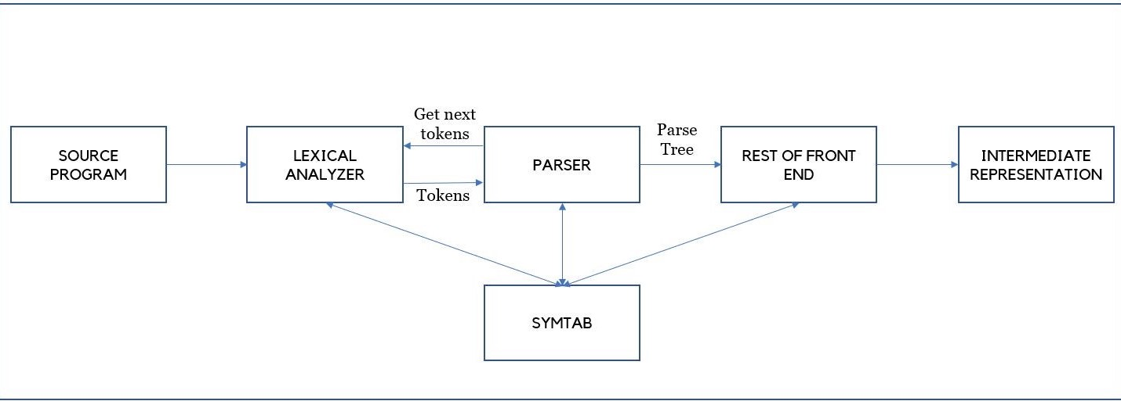
COMPILER MODEL

Slide 5
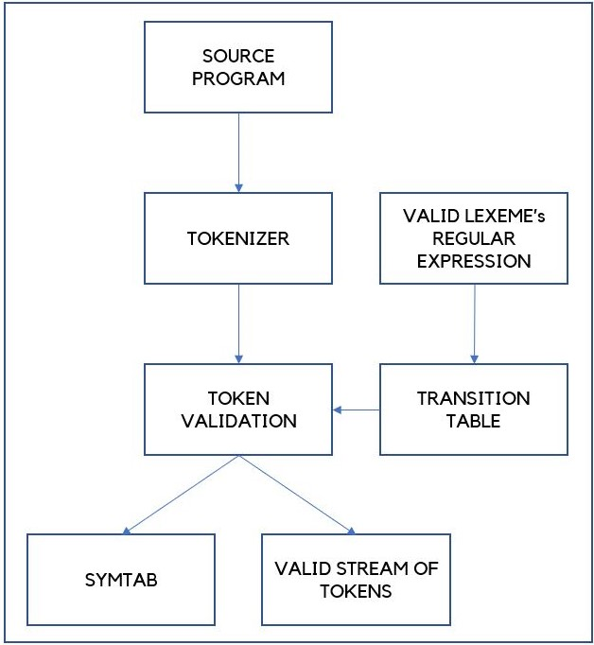
LEXICAL ANALYSER
CONSTRUCTING DFA and TYPE CHECKING
CHECKING SOURCE PROGRAM FOR ERRORS
populate_keywords(…)
is_keyword(…)
is_id(…)
is_literal(…)
is_integer(…)
is_singleline_comment(…)
is_multiline_comment_start(…)
is_multiline_comment_end(…)
parse_input_file(…)
lex(…)

Slide 6
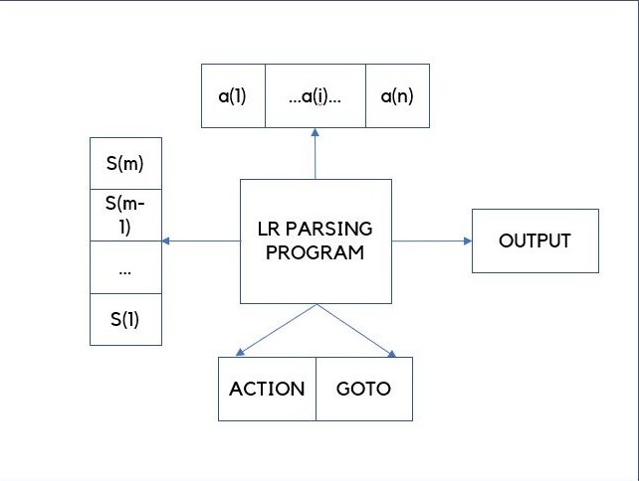
SLR PARSING
FIRST, FOLLOW,CLOSURE and GOTO
PARSING TABLE and SLR PARSING
Calculating FIRST:
  add_to_first(…)
  find_first(…)
  parse(…)
Calculating FOLLOW:
  add_to_follow(…)
  find_follow(…)
  add_to_follow_first(…)
  parse(…)
Calculating CLOSURE:
  canonicalSet(…)
GOTO operations:
  goto_state(…)
  Findposgoto(…)
SLRparsingtable(…)
parser(…)
INPUT
S
T
A
C
K

Slide 7
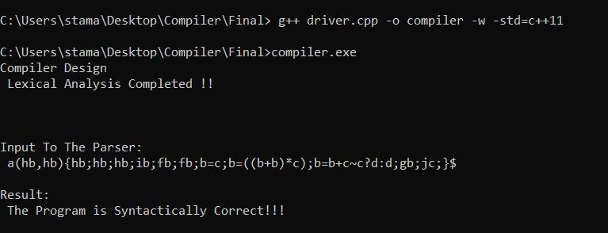
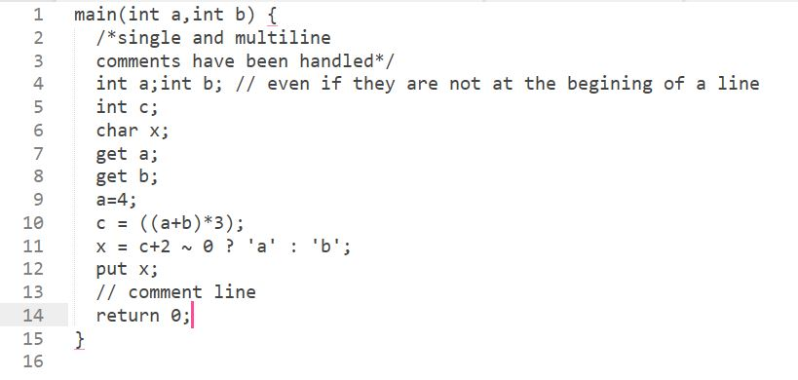
I/0
INPUT:
OUTPUT:
DFA states
SYMTAB
Canonical States
GOTO Transitions
Parsing Table
Parsing Steps

Slide 8
Thank You
ABHAY AGARWALA - 001710501040
BIKRAM BOOTE - 001710501059
PRIYANK LOHARIWAL - 001710501055
TAMAGHNA SARKAR - 001710501057

